Slide 1
ADCANP/CTF Grantee Training 2024
Auburn University Evaluation Team
Francesca Adler-Baeder, Ph.D., CFLE – Principal Investigator
Ami Landers, Ph.D., CFLE – Project Manager
Donna Roland, B.S. – Outreach Programs Administrator
Addison Braddock, M.S., CFLE – Research Associate

Slide 2
Portal Access
Invites to the Portal have already been issued.
Make sure to check your spam folder if you cannot find the email.
For returning grantees, a verification email was sent out. This is used to reactivate your account information in the portal.
All Portal emails will come from portal@ctfeval.com.
Notes:
*If you are unable to access the Portal, please let us know. We can identify the users who have accessed it this year and those who have not. (Do not mention, but there are currently 73 users who have not accessed the Portal this project year.)

Slide 3
Important Changes
User interface and layout changes in the Portal.
The TDSS form has been retired.
Presentation Reports (PRs) are due at the end of the month and feature a new category – Direct Service.
There is now an archive of PY9’s data called the “Vault”
Notes:
CBCAP programs: enter your CBCAP specific information in the direct service category instead of the TDSS. This is not an extra step, just a different place.

Slide 4
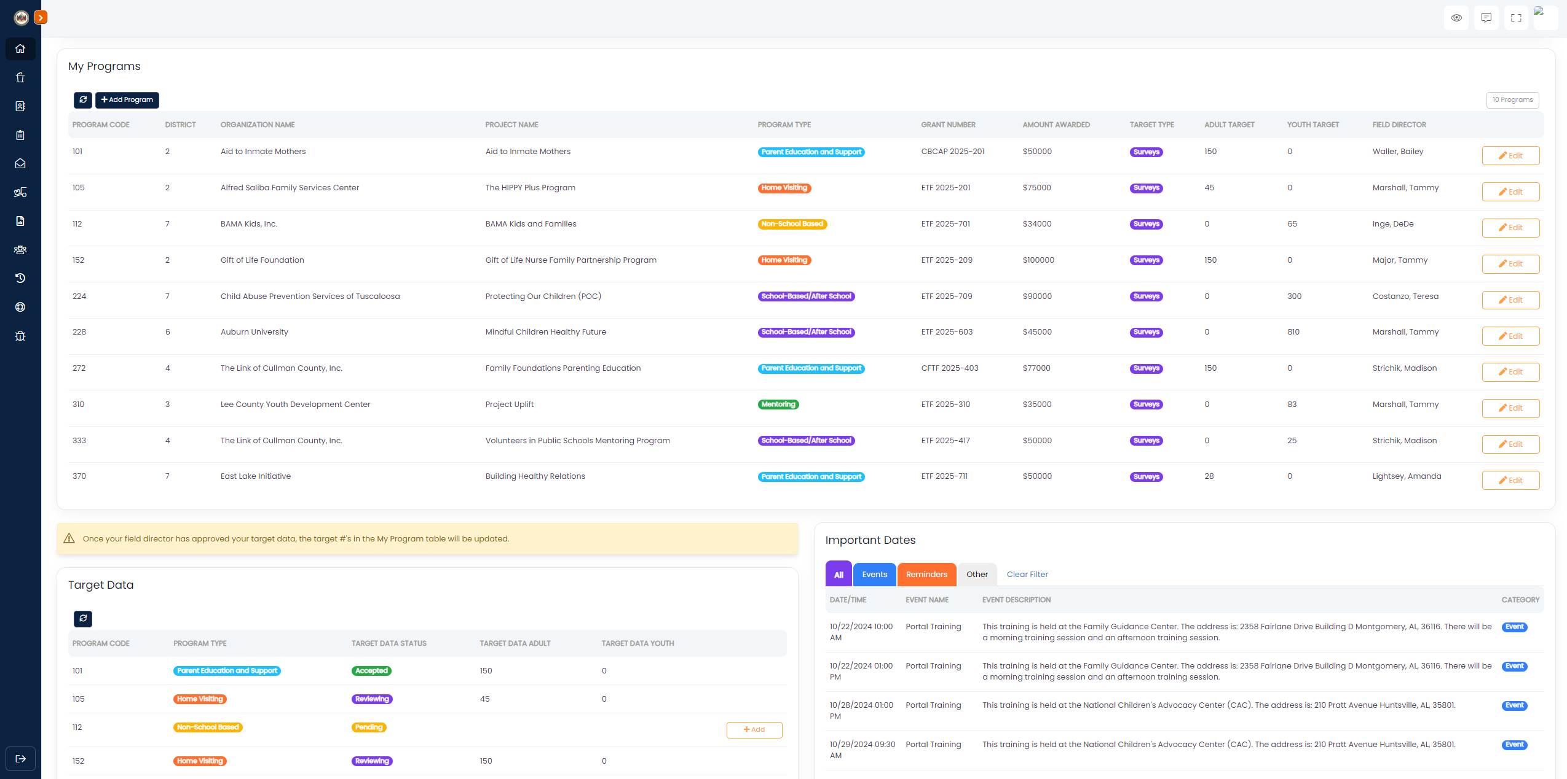
Grantee Home Page
Notes:
This is your grantee home page. Here you can see all the programs you have access to, the surveys sent in, a calendar providing upcoming events or monthly reminders, and your target completion trackers.
On the left slide of the screen is the menu bar, that you will use to navigate to each page within the portal.
In the top right of the screen, you have three icons:
The quote bubble takes you to the team page of our CTF Evaluation website. (Contact Information)
The four boundaries will make the page full screen.
The human icon navigates you to your Portal account settings and permissions. Can upload a photo of yourself for the Portal, here.

Slide 5
Presentation Report Changes
Presentation Reports are now due at the end of the current month.
There are now three types of reports:
Direct Services: participants who are surveyable, but a survey is not an option (Public Awareness, K-2nd graders, and youth served beyond the 300-survey target)
Outreach: standard in-person events / activities
Social Media: social media posts (various platforms); online activity
Notes:
No more “5th of the month for the previous month” deadline. If you cannot add a presentation report by the last day of the month, do not worry. Simply add it for the following month. Simply note that in the “comment section: if you’d like to be specific.

Slide 6
Direct Service Reports
What To Include:
Public Awareness: Each PA program funded has a direct service component. You will report the number of direct services provided to participants.
What Not To Include:
Outreach activities
Social media activities

Slide 7
Outreach Reports
What To Include:
What Not To Include:
Billboards
Meeting with schools to educate children about your program.
Attending a community fair and promoting your program.
Hosting an event / fundraiser for a charity.
Child Abuse Awareness month activity.
Newspaper Articles
Television Ads
Radio Ads

Slide 8
Social Media Reports
What To Include (varies by platform):
What Not To Include:
Public reach, these numbers can be forged.
Engagement (views, likes, reactions) to a post.
Number of times a post / email was opened, or links were clicked.
Screenshots of the post’s analytics page.
Impressions, these aren’t the same as views.
Flyers for the event or social media post itself; we need the analytics page.

Slide 9
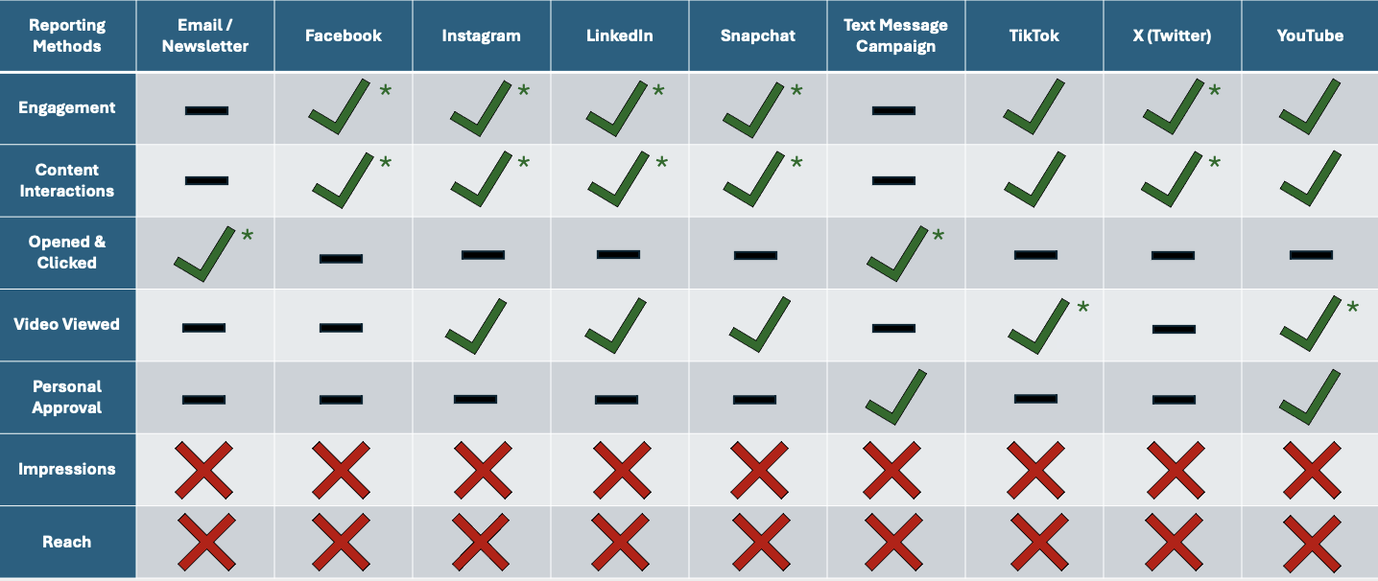
Social Media Platforms
Notes:
These are the 8 different social media platforms you can use for the presentation reports. The “X” signify stats that should not be reported. All the dashes “-”, mark different stats that are irrelevant for that particular social media platform. The “Check marks” represent the analytics that are allowed to included on presentation reports. The asterisks indicate the preferred stat(s) that should be recorded on presentation reports.

Slide 10
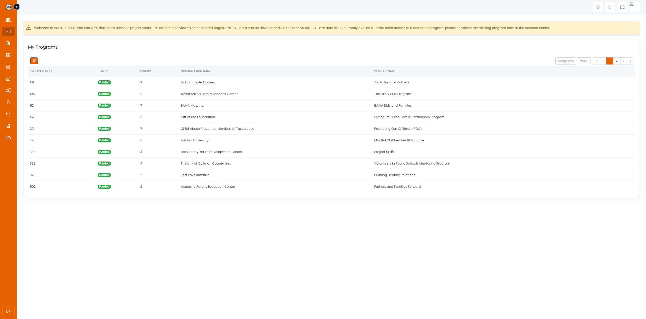
The Vault
The Vault:
This new addition to the Portal is available to both Grantees and Field Directors.
Data from the previous grant year (2022-2023) is now present here, split across all the same tabs as the main Portal.

Slide 11
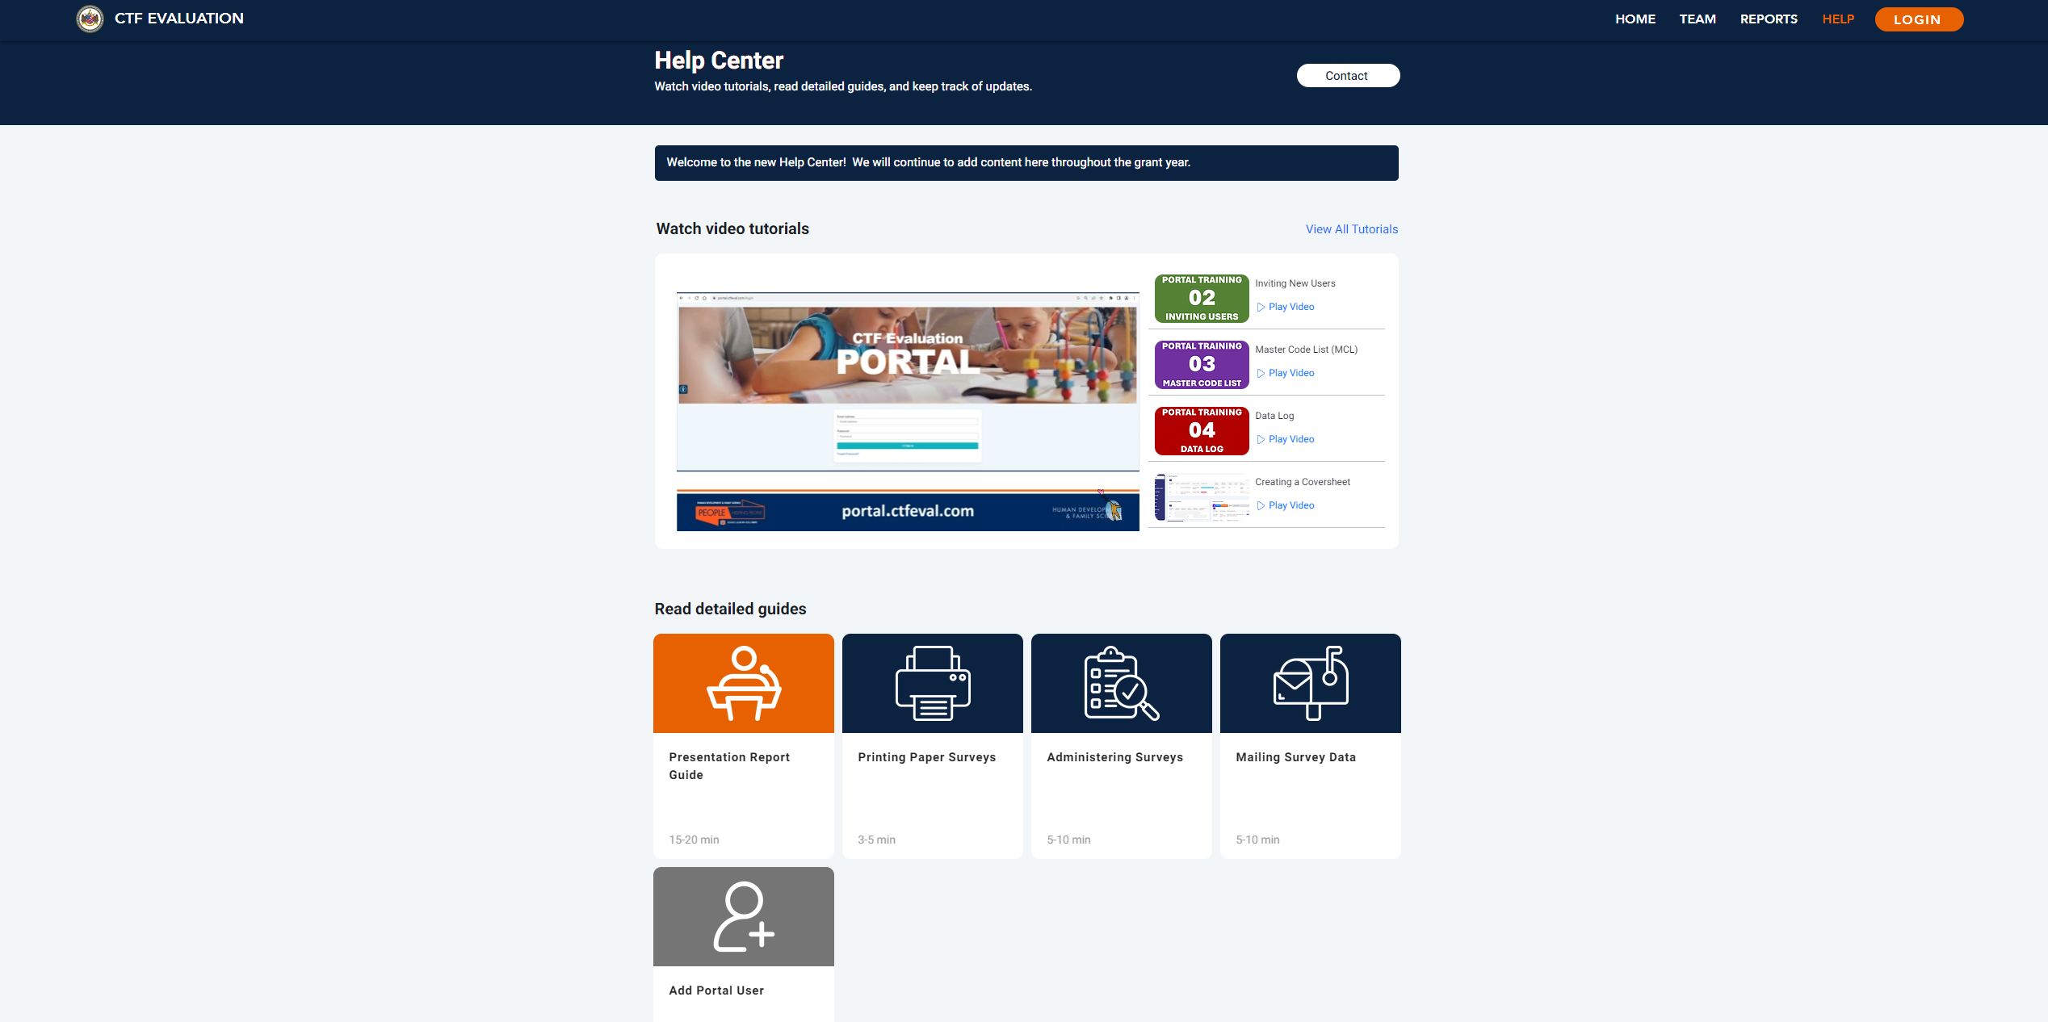
Notes:
This is the Help Center. Here, you can find our team’s contact information, watch video tutorials or read detailed guides explaining elements of the CTF Portal, or access a dictionary to know how we define certain terms used in our reports.

Slide 12
Contact Us!
Please do not hesitate to contact us with any questions you have!
Just make sure to include your AU code in all communication with the CTF Evaluation Team (i.e. subject line of e-mails).
Alternatively, you may utilize the “Feedback” tab on the Portal to notify us of any bugs that you come across.
Ami Landers: alanders@auburn.edu or (334) 201-4543
CTF Evaluation: ctfeval@auburn.edu or (334) 844-8751
Donna Roland: rolandj@auburn.edu
Addison Braddock: addison@auburn.edu

