Slide 1


ADCANP/CTF
Grantee Training 2024
Auburn University Evaluation Team
Francesca Adler-Baeder, Ph.D., CFLE – Principal Investigator
Ami Landers, Ph.D., CFLE – Project Manager
Donna Roland, B.S. – Outreach Programs Administrator
Addison Braddock, M.S., CFLE – Research Associate

Slide 2

Portal Access
Invites to the Portal have already been issued.
Make sure to check your spam folder if you cannot find the email.
For returning grantees, a verification email was sent out. This is used to reactivate your account information in the portal.
All Portal emails will come from portal@ctfeval.com.
Notes:
*If you are unable to access the Portal, please let us know. We can identify the users who have accessed it this year and those who have not. (Do not mention, but there are currently 73 users who have not accessed the Portal this project year.)

Slide 3
Important Changes
User interface and layout changes in the Portal.
The MCL is linked with your data logs (digital surveys).
The TDSS form has been retired.
Presentation Reports (PRs) are due at the end of the month and feature a new category – Direct Service.
2025 Edition of Coversheets & Surveys
There is now an archive of PY9’s data called the “Vault”
Notes:
CBCAP programs: enter your CBCAP specific information in the direct service category instead of the TDSS. This is not an extra step, just a different place.

Slide 4
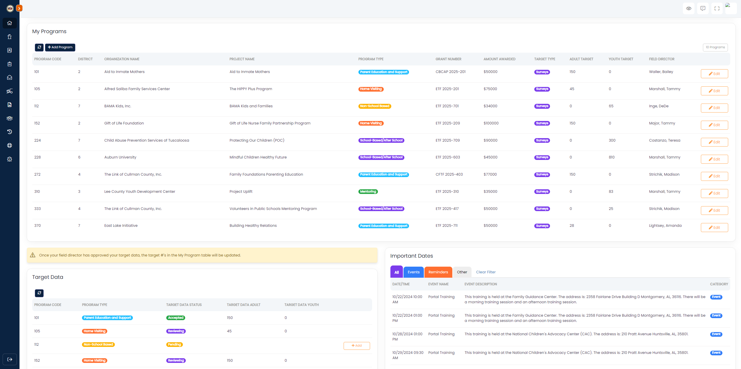
Grantee Home Page
Notes:
This is your grantee home page. Here you can see all the programs you have access to, the surveys sent in, a calendar providing upcoming events or monthly reminders, and your target completion trackers.
On the left slide of the screen is the menu bar, that you will use to navigate to each page within the portal.
In the top right of the screen, you have three icons:
The quote bubble takes you to the team page of our CTF Evaluation website. (Contact Information)
The four boundaries will make the page full screen.
The human icon navigates you to your Portal account settings and permissions. Can upload a photo of yourself for the Portal, here.

Slide 5
Presentation Report Changes
Presentation Reports are now due at the end of the current month.
There are now three types of reports:
  Direct Services: participants who are surveyable, but a survey is not an option (Public Awareness, K-2nd graders, and youth served beyond the 300-survey target)
  Outreach: standard in-person events / activities
  Social Media: social media posts (various platforms); online activity
* IMPORTANT: If you are not a Public Awareness program, prioritize submitting surveys, not presentation reports*
Notes:
No more “5th of the month for the previous month” deadline. If you cannot add a presentation report by the last day of the month, do not worry. Simply add it for the following month. Simply note that in the “comment section: if you’d like to be specific.

Slide 6


Direct Service Reports
PUBLIC AWARENESS, CBCAP, YOUTH PROGRAMS
What To Include:
Public Awareness: Each PA program funded has a direct service component. You will report the number of direct services provided to participants.
CBCAP: Enter CBCAP specific information (i.e., # of families, # of individuals with disabilities, etc.) as a direct service instead of on the TDSS.
Youth: Enter the participants who received programming but were not surveyed (i.e., K – 2nd graders, youth served beyond the 300-survey target).
What Not To Include:
Outreach activities
Social media activities

Slide 7
Outreach Reports
What To Include:
What Not To Include:
Billboards
Meeting with schools to educate children about your program.
Attending a community fair and promoting your program.
Hosting an event / fundraiser for a charity.
Child Abuse Awareness month activity.
Newspaper Articles
Television Ads
Radio Ads

Slide 8
Social Media Reports
What To Include (varies by platform):
What Not To Include:
Public reach, these numbers can be forged.
Engagement (views, likes, reactions) to a post.
Number of times a post / email was opened, or links were clicked.
Screenshots of the post’s analytics page.
Impressions, these aren’t the same as views.
Flyers for the event or social media post itself; we need the analytics page.

Slide 9
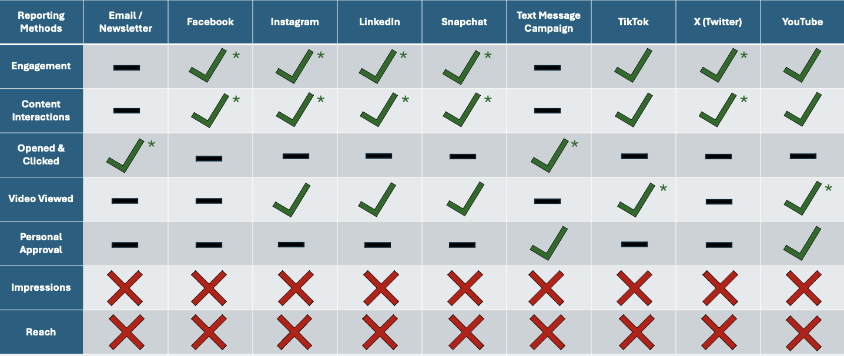
Social Media Platforms
Notes:
These are the 8 different social media platforms you can use for the presentation reports. The “X” signify stats that should not be reported. All the dashes “-”, mark different stats that are irrelevant for that particular social media platform. The “Check marks” represent the analytics that are allowed to included on presentation reports. The asterisks indicate the preferred stat(s) that should be recorded on presentation reports.

Slide 10
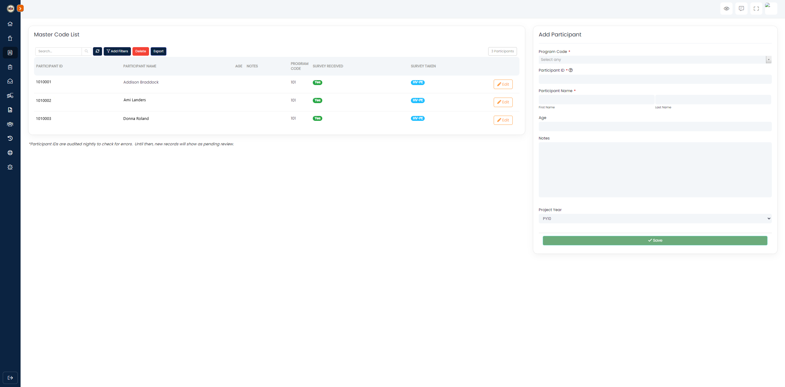
Master Code List
Master Code List:
All surveyed participants need to be added to the MCL (applies to paper and digital surveys).
New feature: Once the surveys have been received, the MCL will update to say under Survey Received.
Before a participant can submit a digital survey, the Participant ID must be entered into the Portal.
Refresh the “Survey” page after all Participant IDs are created before continuing.

Slide 11
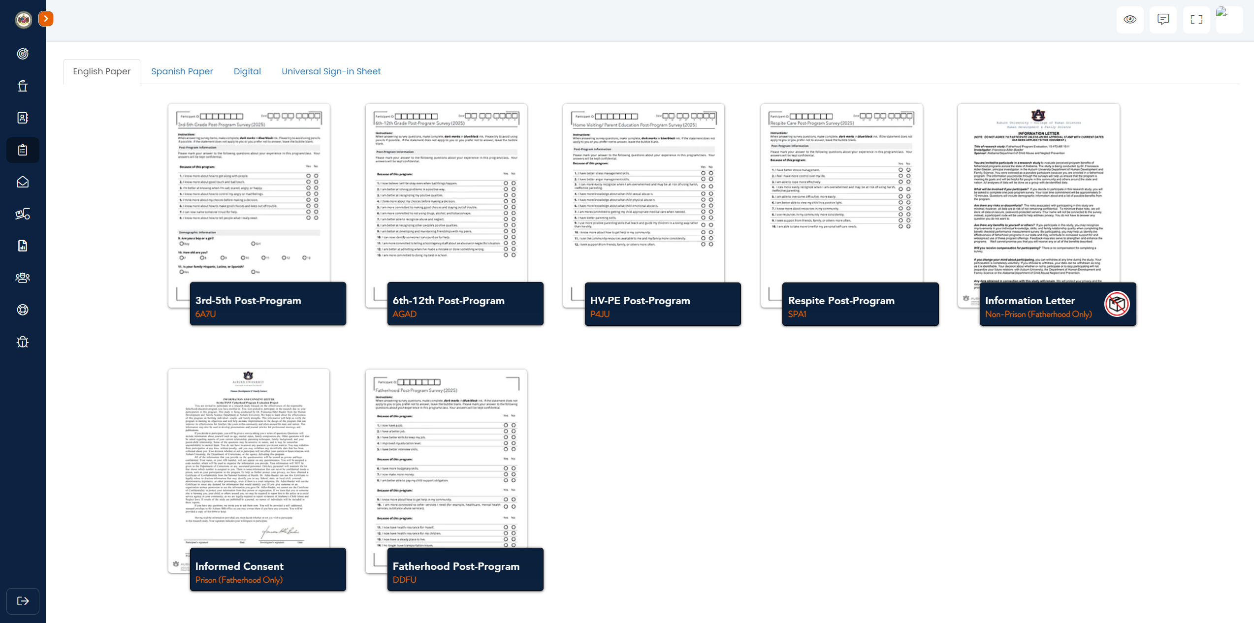
Survey Pages

Slide 12
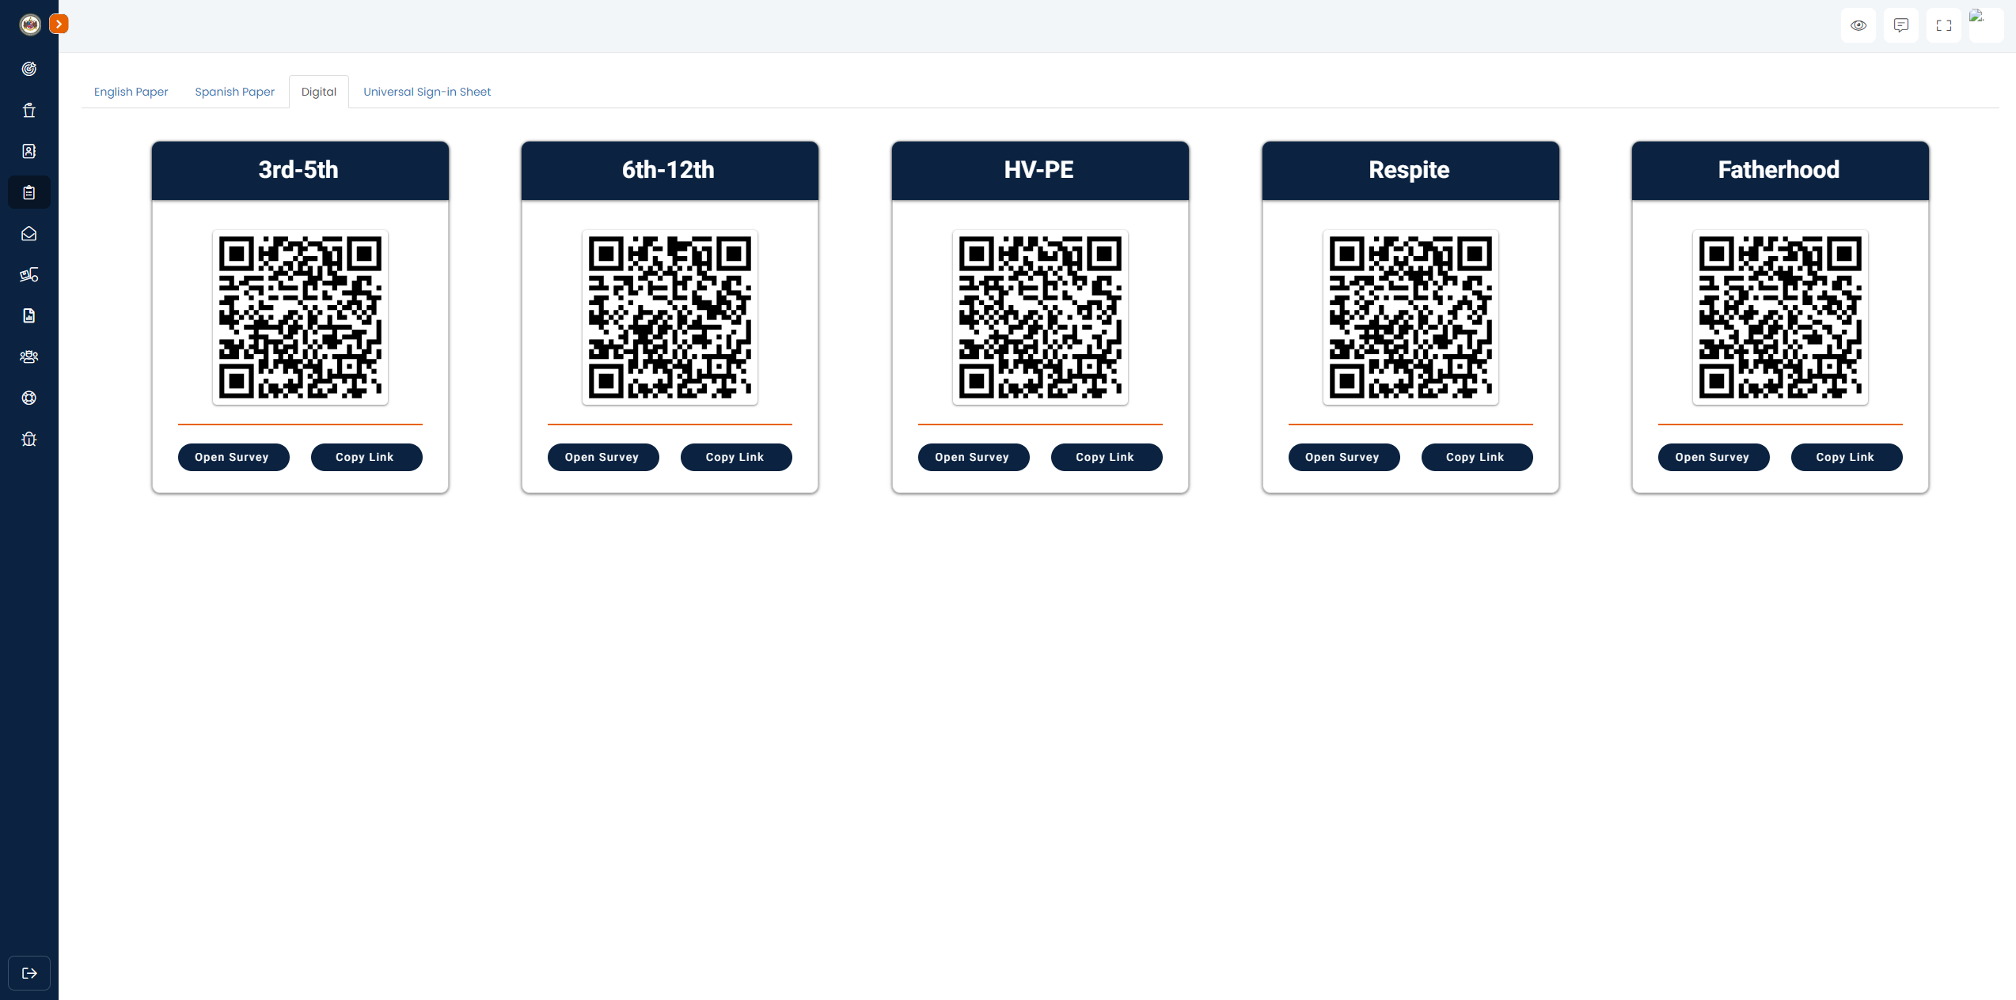

Survey Pages
Digital Surveys:
Here are the links to access the online surveys. Click or download the QR codes by clicking them.
There is now a dropdown option on the survey of the participants IDs entered on your MCL, so you MUST enter them before administering surveys.
A new question in the survey will ask the participant to verify their initials.
Notes:
Qualtrics is a “brand” name similar to Kleenex for tissue. We are not using the brand “Qualtrics” any longer. With this change, you will no longer receive e-mail notifications when a participant submit a survey. This is great – WHY? Because the electronic surveys we are using now is integrated with the Portal. This means that as soon as a participant submits an electronic/digital survey, their status updates almost simultaneously in the Portal. YAY!

Slide 13
Survey Reminders
All surveys have changed. Old surveys will not be accepted.
Print surveys directly from The Portal each time.
Make sure that all four corners and the QR code are completely visible on EVERY page for each survey.
Participant IDs should start with your program’s 3-digit AU code.
Pens are preferred.
Do not staple, paper clip, or fold surveys.

Slide 14
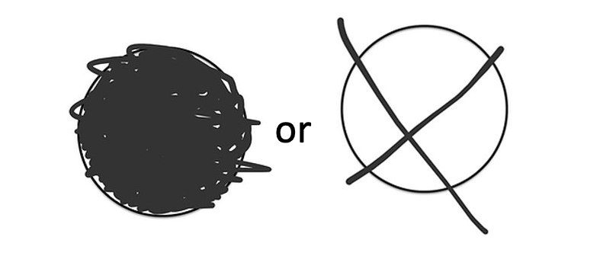
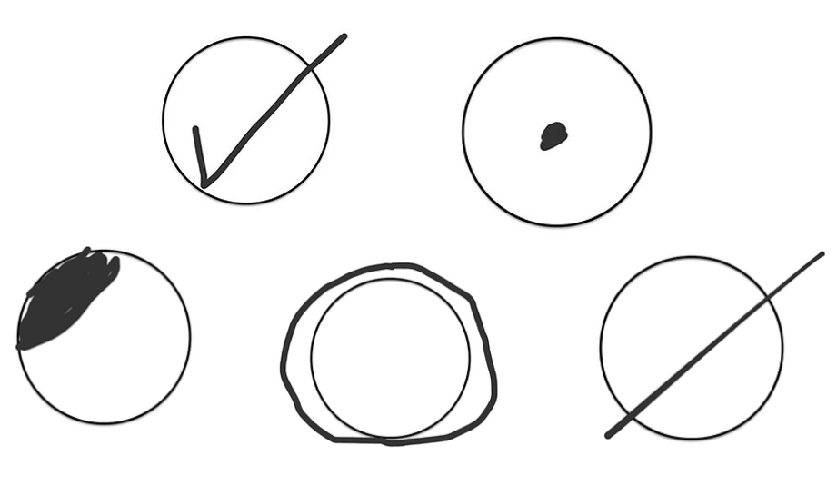
How to Mark Surveys
Correct
Incorrect
Notes:
Here you can see the correct and incorrect ways to mark responses.
Marking an “X” is acceptable. It is your responsibility to ensure participants fill surveys out correctly. Check surveys before mailing to Auburn.
Pens are preferred, use pens PLEASE!

Slide 15
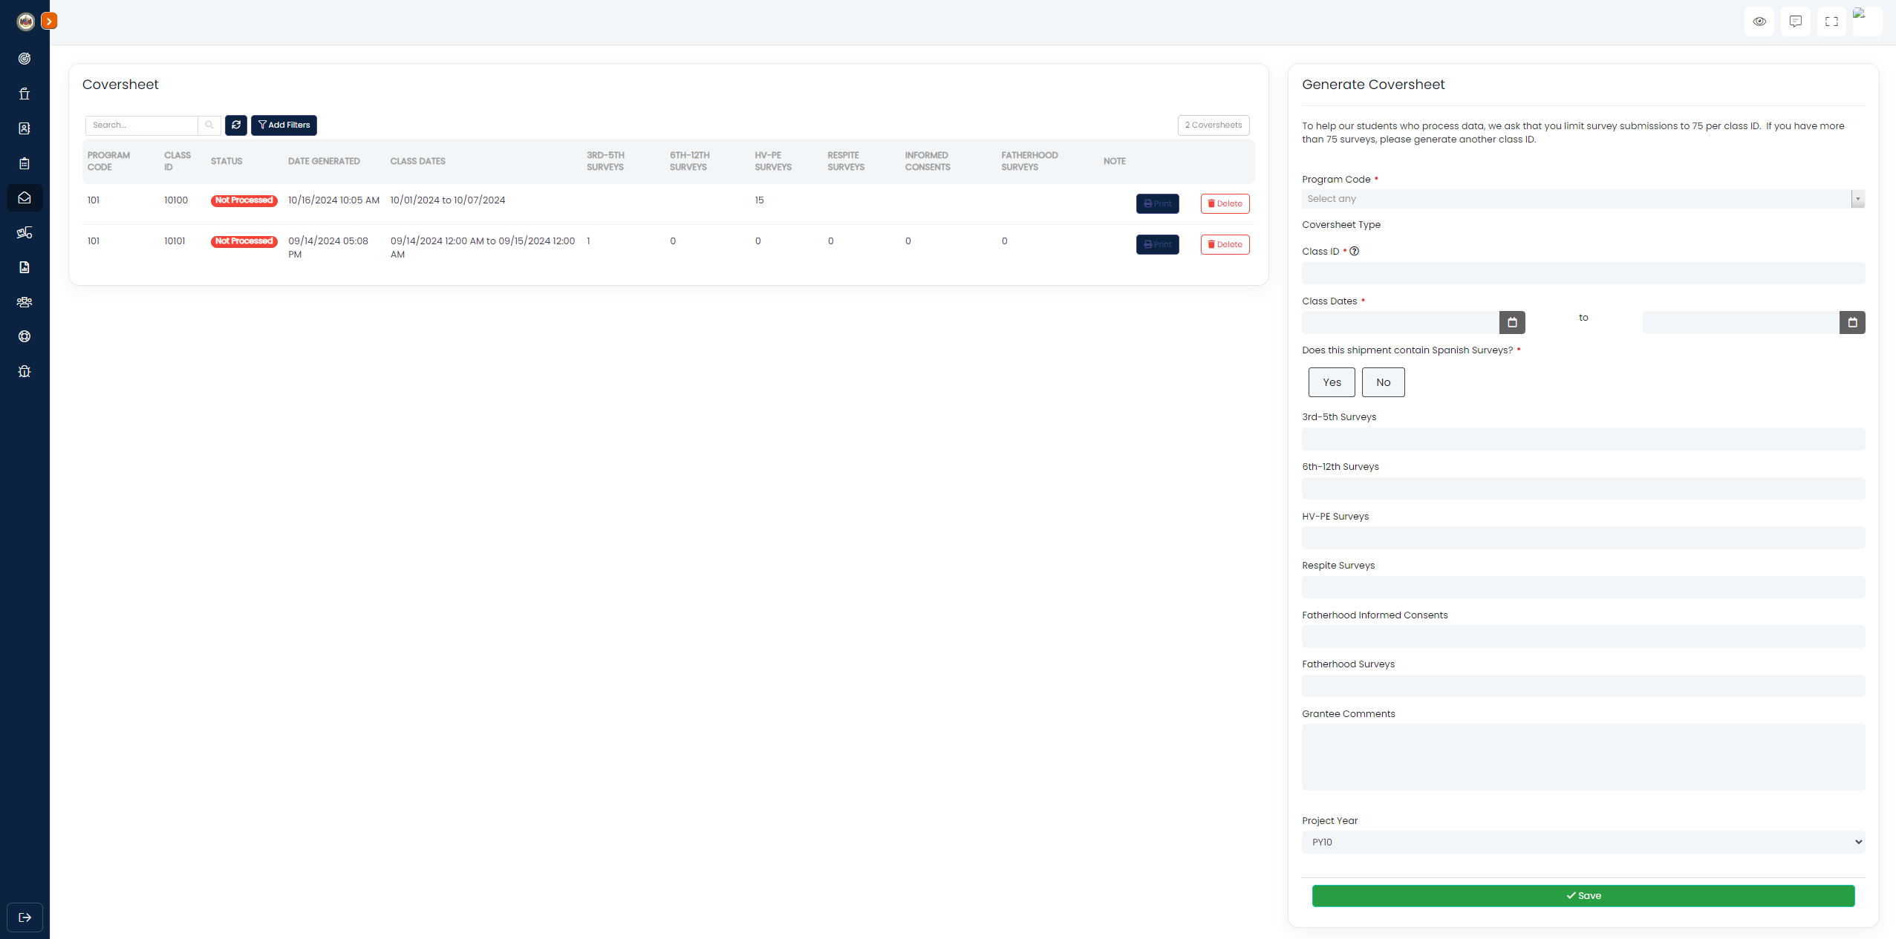

Coversheet Page
Coversheet Page:
All the steps to generate a new coversheet are visible here.
There is an option to state whether the class contains Spanish surveys. *new this year
Make sure to print the coversheet by clicking , it must be mailed along with all the physical surveys.
Notes:
To generate a new coversheet, fill in the appropriate data on the right side of the page. Make sure to fill in the form top to bottom because certain fields can hide, depending on the inputs provided.
*Denoting Spanish surveys: you do NOT need to mail Spanish surveys separately; just tell us if the shipment contains Spanish surveys and how many.

Slide 16
Mailing Data to Auburn
Guidelines:
Make sure each envelope is sent with your program specific Data Coversheet. Print from The Portal.
Do not staple or paper clip surveys.
Mail data to AU Evaluation Team within 5 days of completing your class! You should not hold onto surveys and send hundreds together.
Notes:
This information only applies to paper surveys.
We understand that if each class ID can only hold 75 surveys, you may have several Data Coversheets with the same date. That is fine! Simply change the class ID on the next data coversheet. *We are reasonable: if you have 76 surveys, do not mail 75 in one packet and 1 in the next.
Think of a Data Coversheet and Class ID as a “packing slip”. A data coversheet is needed for each packet of data shipped to us. Once a packet contains 75 surveys, a new data coversheet should be created for a new packet. The data coversheet will contain the next, sequential class ID.
Class IDs should be sequential. 30101, 30102, and so on.

Slide 17
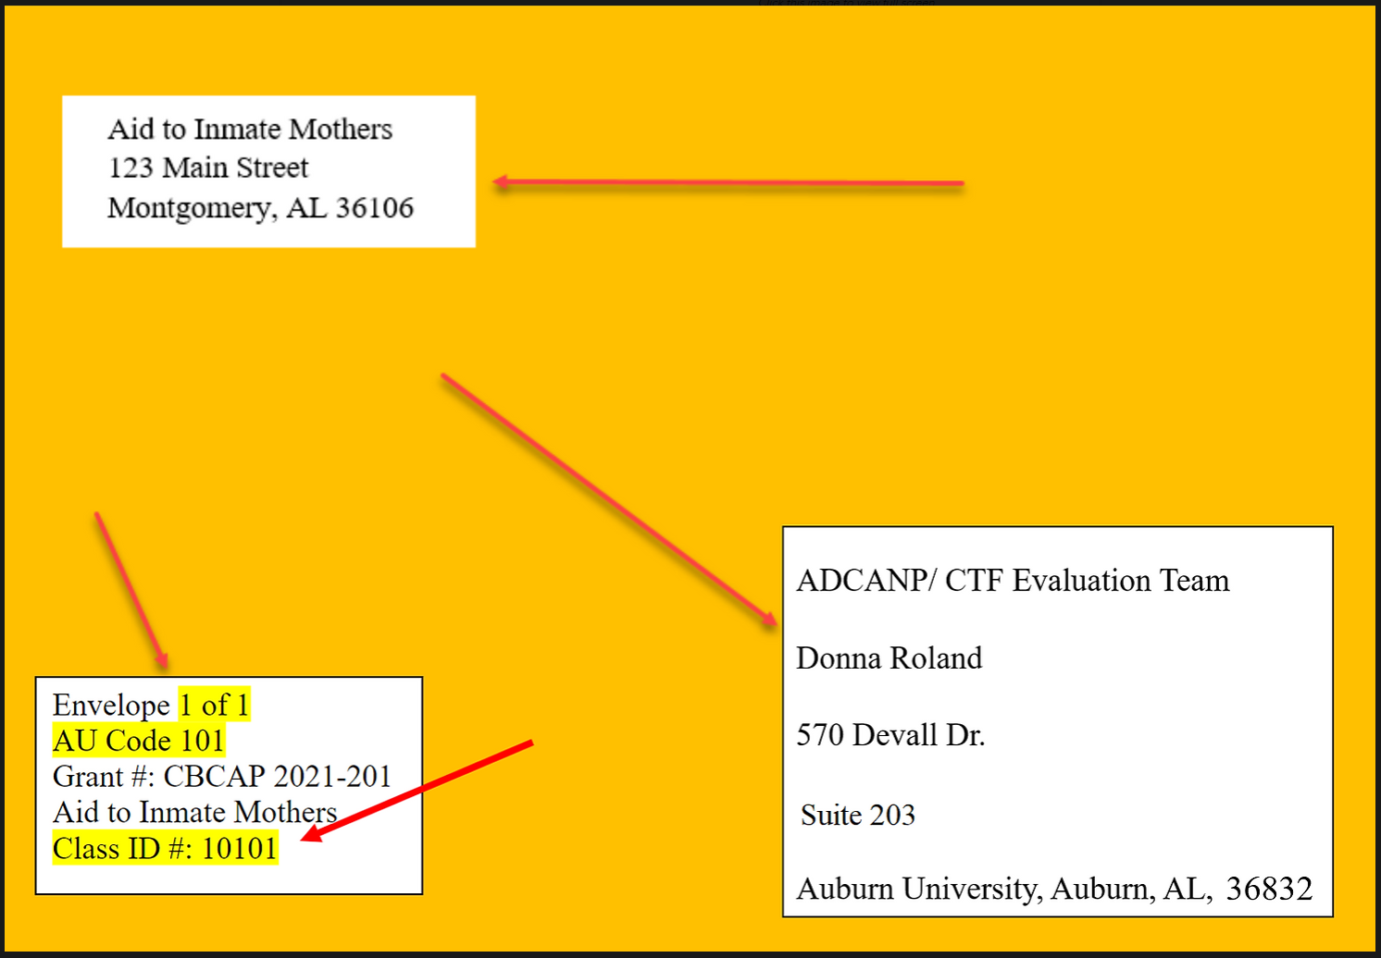
Mailing Data to Auburn
Notes:
Key Components for Envelopes:
Must be mailed to Donna Roland.
Address is 570 Devall Dr., Suite 203.
Should reflect your AU Code and Class ID of the shipment.
Ideally, have a 1 of __ on the shipment, so we know the number of envelopes that correspond to the class. Think of your Class ID as a shipment ID, meaning for every packet of data you mail to AU Evaluation, the packet has a unique 5-digit ID.

Slide 18
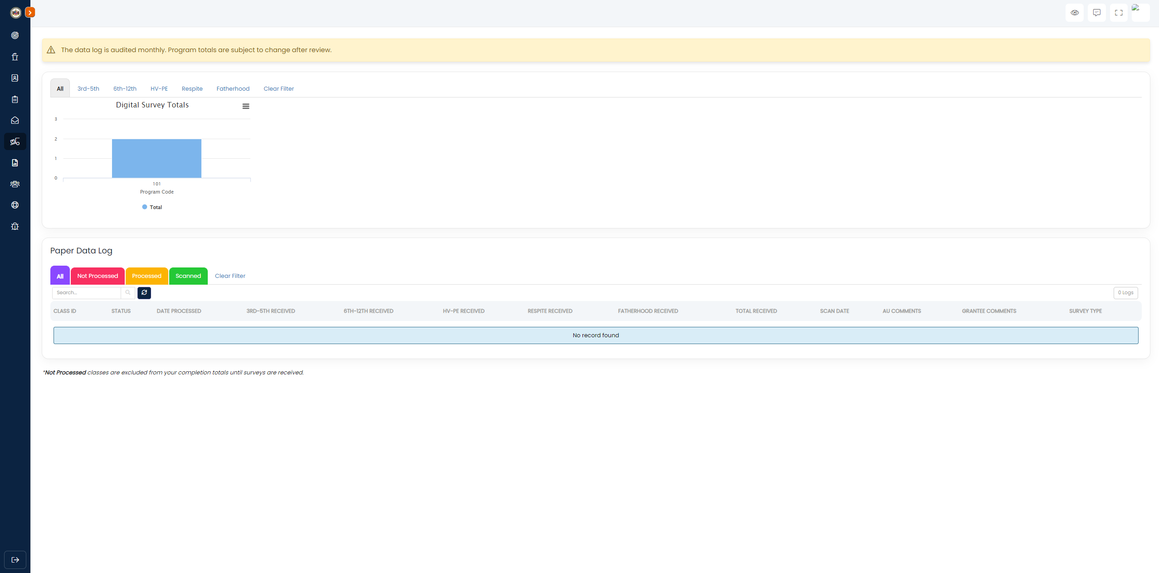
Data Logs Page
Digital Surveys:
Here is where digital surveys will be displayed for each of your programs.
Data Log Page:
Now the data logs are partitioned into Paper and Digital surveys.
Paper surveys function the same as last year.
There is now a button that identifies surveys lost during mailing.
Notes:
The Data Logs page has now been split into two parts. The upper shows digital surveys submitted, and the lower half displays the paper surveys like normal.
Features to be aware of:
There is a button that can identify surveys that have been lost during the mailing process.
After two weeks, if a class has not been updated to be Processed or Verified, an email reminder will be sent out telling you to mail the class.

Slide 19
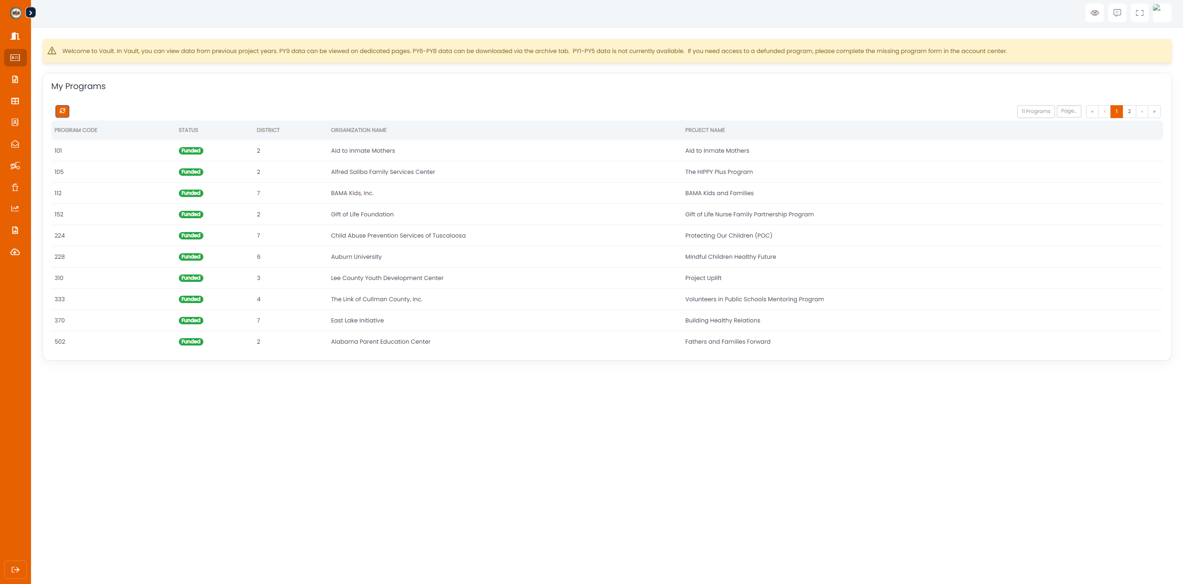
The Vault
The Vault:
This new addition to the Portal is available to both Grantees and Field Directors.
Data from the previous grant year (2022-2023) is now present here, split across all the same tabs as the main Portal.

Slide 20
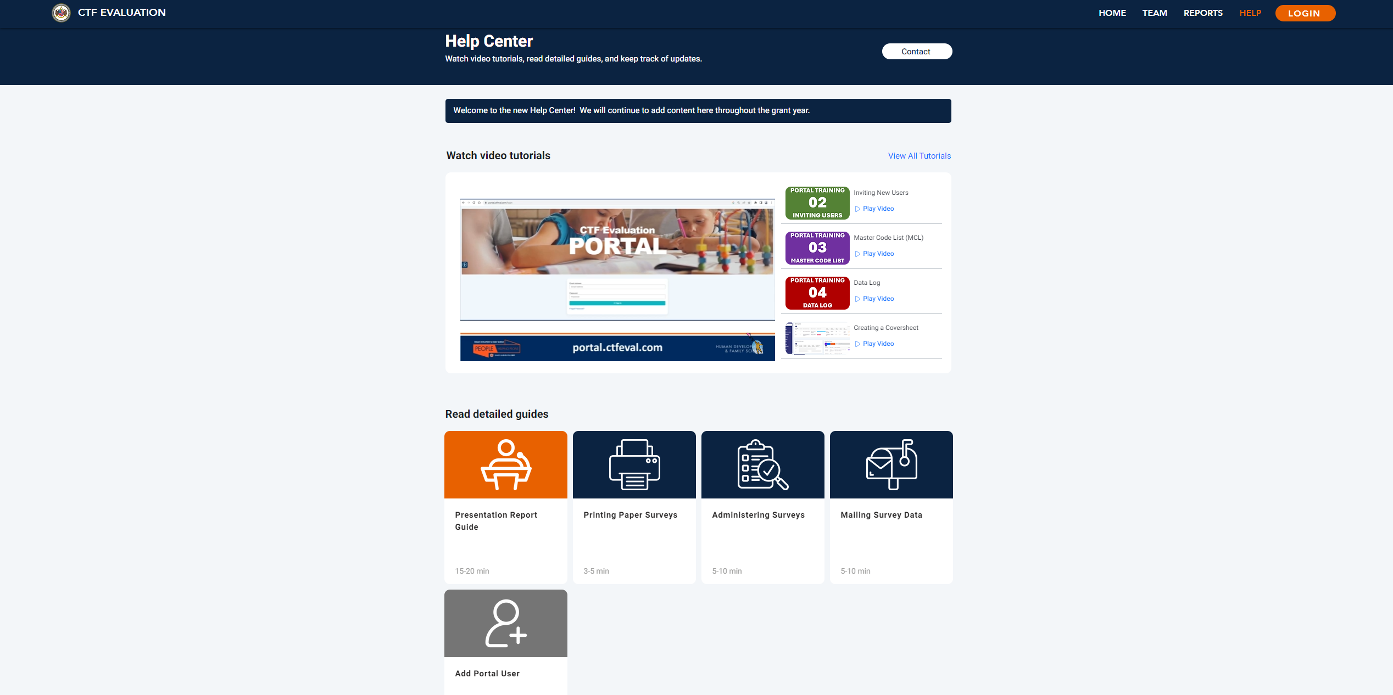
Notes:
This is the Help Center. Here, you can find our team’s contact information, watch video tutorials or read detailed guides explaining elements of the CTF Portal, or access a dictionary to know how we define certain terms used in our reports.

Slide 21
Contact Us!
Please do not hesitate to contact us with any questions you have!
Just make sure to include your AU code in all communication with the CTF Evaluation Team (i.e., subject line of e-mails).
Alternatively, you may utilize the “Feedback” tab on the Portal to notify us of any bugs that you come across.
Ami Landers: alanders@auburn.edu or (334) 201-4543
CTF Evaluation: ctfeval@auburn.edu or (334) 844-8751
Donna Roland: rolandj@auburn.edu
Addison Braddock: addison@auburn.edu

